Slide 1
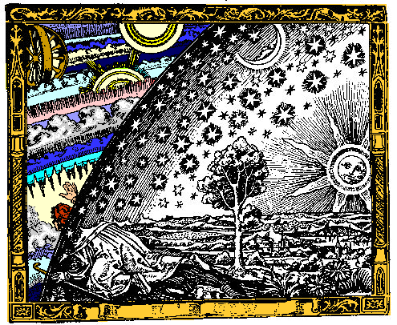
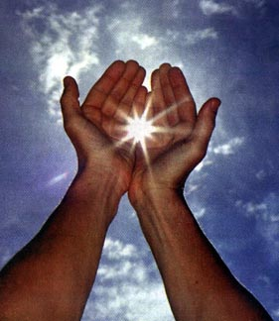
The Scientific Revolution:
Renaissance & Reformation broke down Medieval worldview
Heart of Scientific Revolution: assumption that mathematical laws governed nature & Universe
Therefore…physical world can be understood, managed & shaped by people!!!!

Slide 2
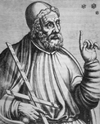
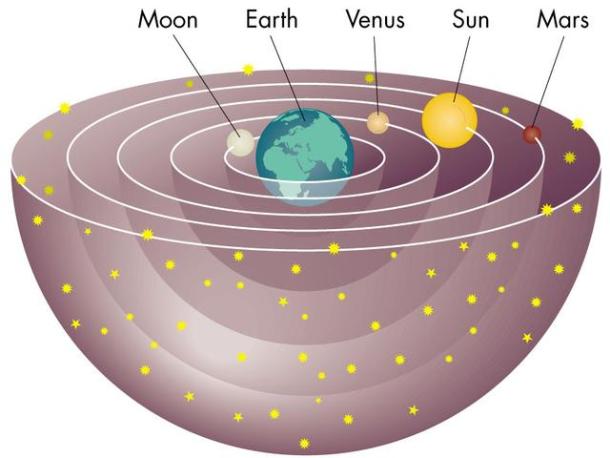
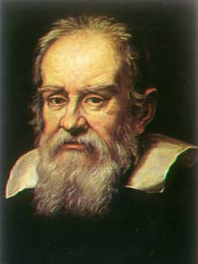
Many Changes had to do with science……..
In the middle ages the common belief was in a GEOCENTRIC, or Earth Centered Universe
Ptolemy
Previously followed theories of ancient Greeks Ptolemy & Aristotle
1543 – Copernicus proposed a HELIOCENTRIC, Sun-centered model of the universe

Slide 3
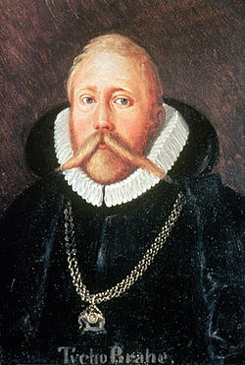
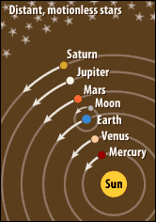
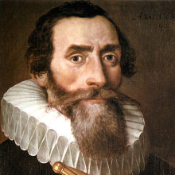
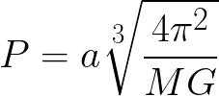
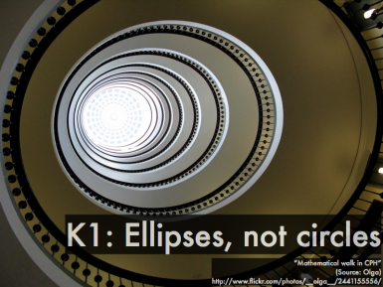
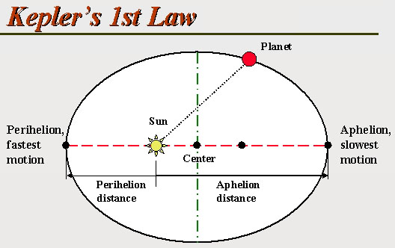
Late 1500s – Tycho Brahe provided evidence, supported Copernicus’s view (w/observatory)
Brahe
Johannes Kepler – used Brahe’s data to calculate planets revolving around Sun
Proved oval-shaped , elliptical orbit, not round as previously thought!
Of planetary motion

Slide 4
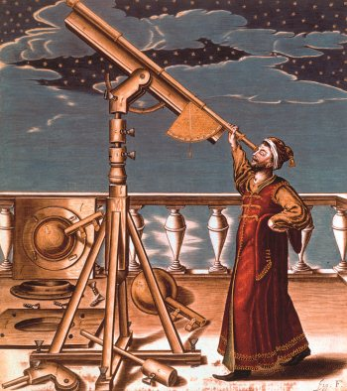
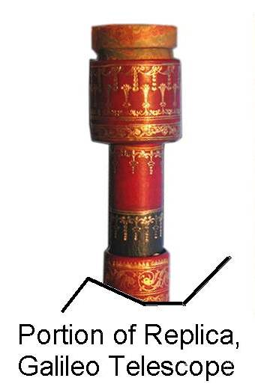
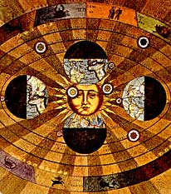
GALILEO builds a telescope to prove Copernicus's view of the world - the HELIOCENTRIC - or Sun Centered Universe
His discovery caused an uproar!
Contradicted ancient views of Earth as center of universe
Church condemned him
They taught that heavens were in perfect fixed position to Earth

Slide 5
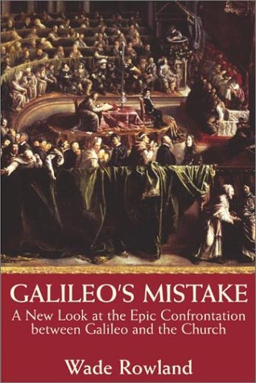
1633 -Galileo is found guilty by Catholic Church of being a heretic in the Inquisition
At least he always had a good sense of humor!

Slide 6
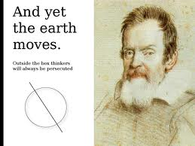
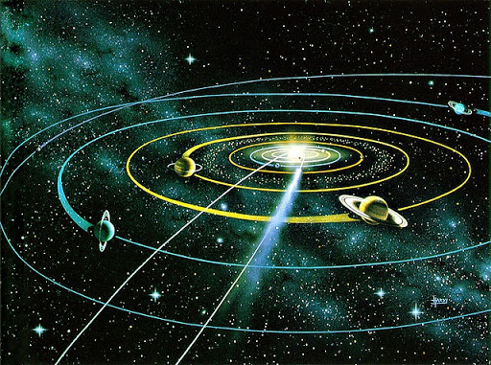
Galileo put under house arrest
Threatened with death unless he withdrew “heresies”
He agreed to state publicly in court that the Earth stands motionless in center of universe
As he left court, he muttered, “And yet it moves.”

Slide 7
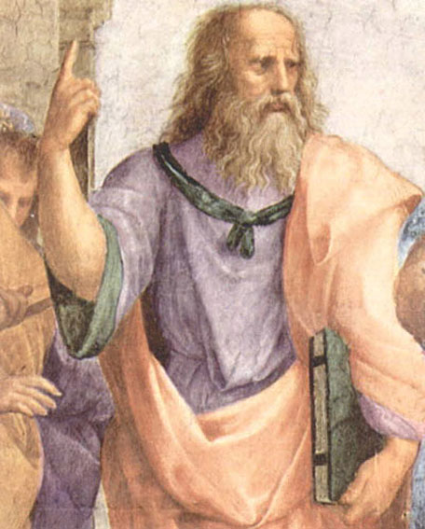
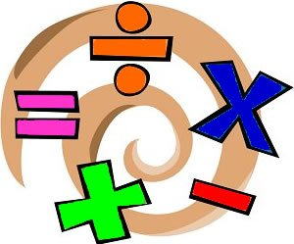
A New Scientific Method
Greek philosopher Plato was rediscovered, believed:
Man should look beyond simple appearances to learn truth
Mathematics was key to learning
Math Rocks!!

Slide 8
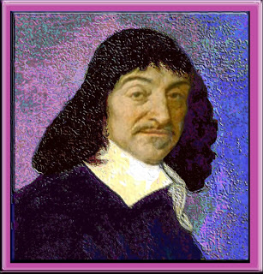
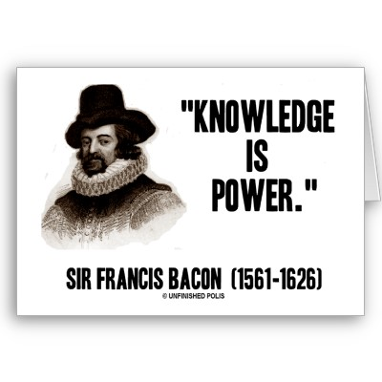
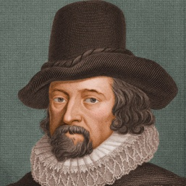
Englishman Francis Bacon & Frenchman Rene Descartes:
Both devoted to understanding how truth is determined
Challenged medieval view that world had to fit teachings of the Church
Must investigate to find truth
“I think, therefore I am.” Descartes

Slide 9
Over time a step-by-step process of discovery evolved:

Slide 10
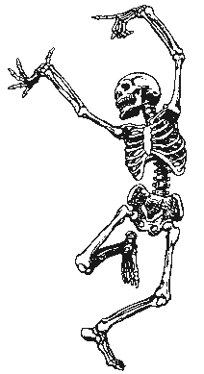
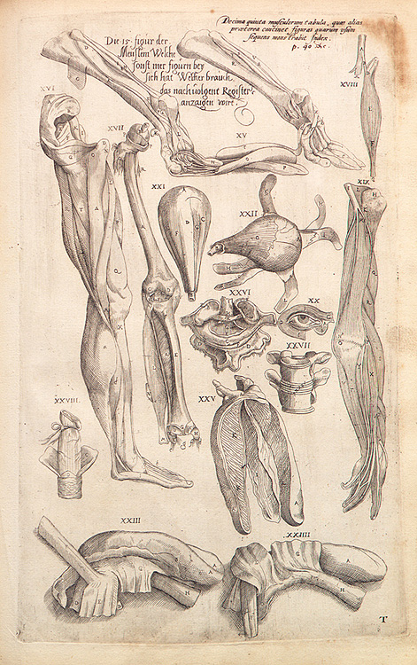
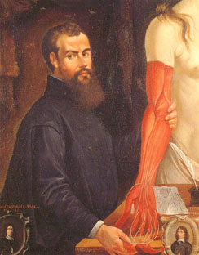
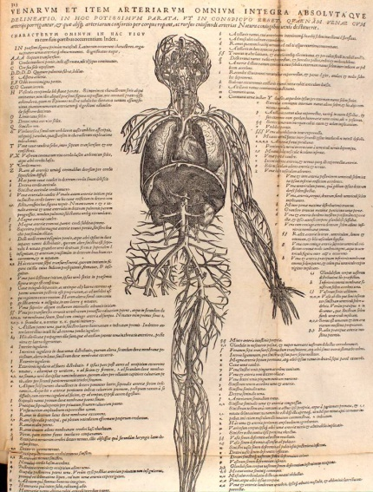
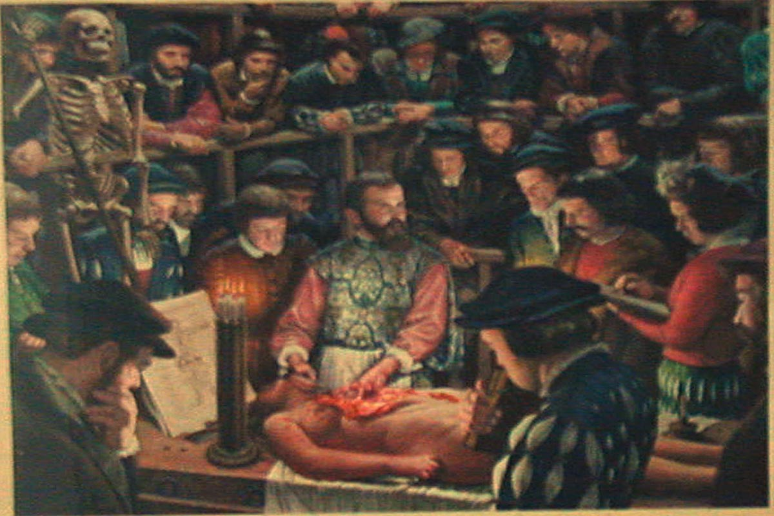
1543 – Andreas Vesalius published On the Structure of the Human Body
An accurate, detailed study of human anatomy
He autopsied bodies he obtained – illegal at this time!!!
Friends in the government looked the other way

Slide 11
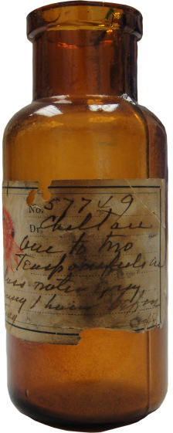
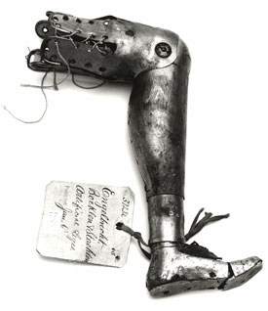
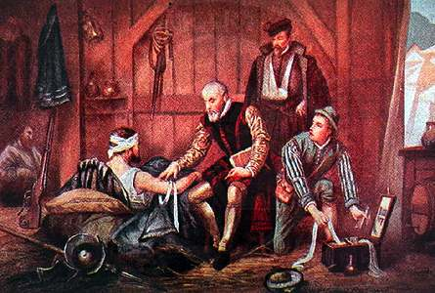
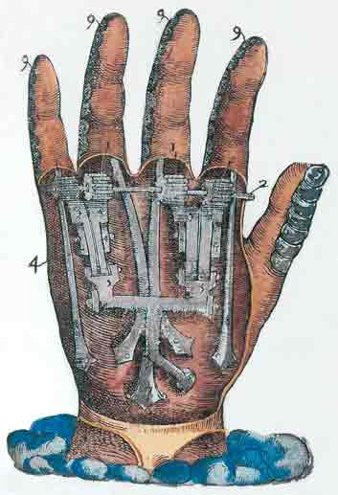
1540 – Ambroise Pare developed:
Ointment to prevent infections
New surgical techniques
Invented scientific instruments
Introduced use of artificial limbs!!!
WOW!!!

Slide 12
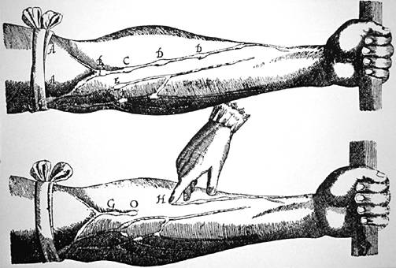
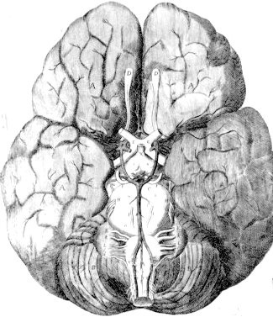
William Harvey determined that the heart pumped blood throughout the body

Slide 13
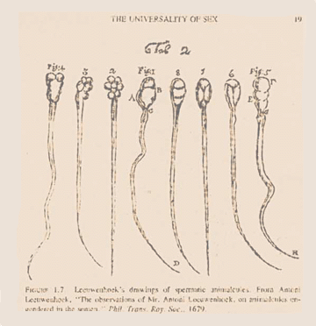
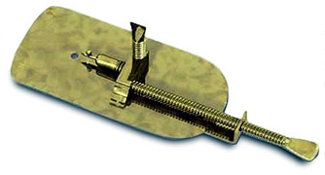
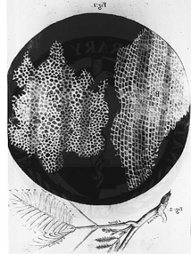
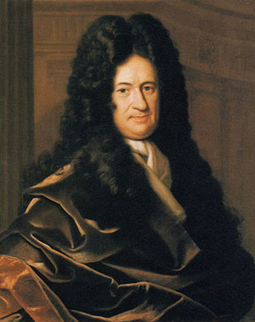
The Dutch inventor Anton Van LEEUWENHOEK perfected the microscope
ROBERT HOOKE, an English scientist, used the microscope to discover cells, the basic building blocks of living things
A TINY NEW WORLD IS DISCOVERED!!!

Slide 14
ROBERT BOYLE
“The Father of Chemistry”
Refined alchemists view of chemicals as basic building blocks
Distinguished between chemical elements & compounds
Determined that all matter is composed of tiny particles that behave in a certain way, corpuscular philosophy of atoms -
an early form of the atomic theory of matter
Scientists built on Boyle’s ideas which laid the foundation for Dalton’s modern ATOMIC THEORY
Reconciled God & Science

Slide 15
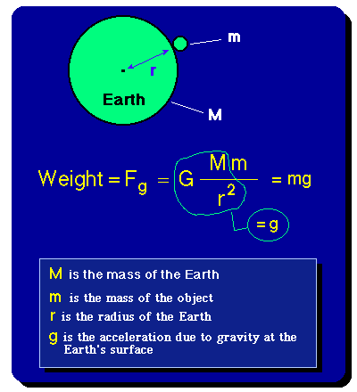
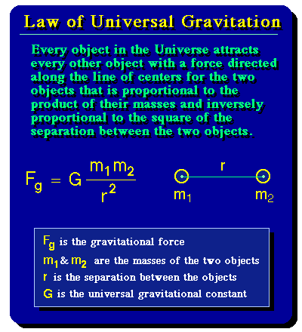
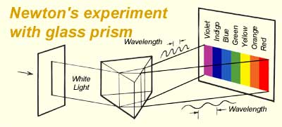
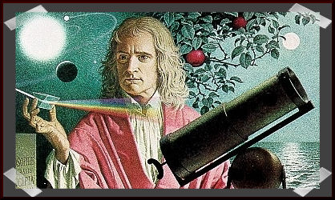
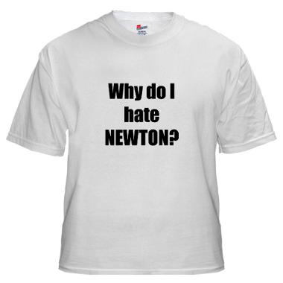
ISAAC NEWTON
Using mathematics he proved that a single force keeps the planets in orbit around the Sun
He called this force GRAVITY!
1687 – published a book
Explaining gravity
Nature follows uniform laws
Universe can be measured & described mathematically
Newton helped to develop CALCULUS to explain his laws ……gee…thanks Isaac!

